Slide 1

STAFFING
GOALS & VISION FOR THE FUTURE
For 2024

Slide 2
Organizational Chart
Board of Directors
Executive Committee
Executive
Director
Georgina Tegart
Fund Dev. Officer
Dustin Olson
Administrative Assistant
Community
Impact
Marketing and
Communications
Donor Relations
Amber Lenz
Liz Forster
Ray Pagenkopf
Laura Giammttei

Slide 3
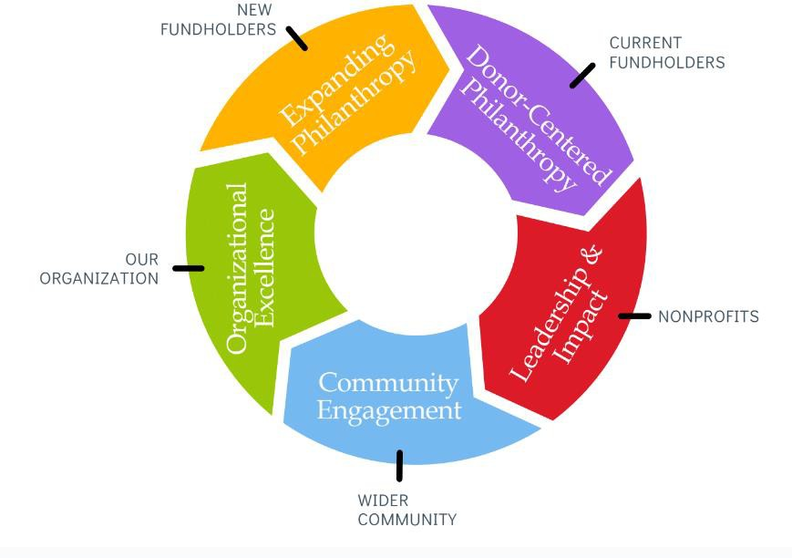
STRATEGIC PRIORITIES SUMMARY
Community Engagement
Grow both endowed and grantmaking $$ for our strategically positioned funds - Education and Common Good - all crowdsourced and all online.
Reach a more diverse audience of donors through timely online giving campaigns
Connect the community with local nonprofit needs
Grow our brand and Name Recognition in the Community

Slide 4
STRATEGIC PRIORITIES SUMMARY
Donor-Centered Philanthropy
Focus on our current fundholders - inspire them to grow their funds by contributing new dollars; to endow their funds in perpetuity; and to award more grants and strategic grants.
Ensure high quality interactions and foster long-term investment by all of our fundholders
Increase our focus on ongoing philanthropic services to promote/encourage charitable giving through enhanced donor contact and events that focus on education, appreciation and collaboration.
Increase our focus on consistent and ongoing donor stewardship
and philanthropic services to promote charitable giving
Leadership & Impact
Expand our services to nonprofits.
Strengthen our nonprofit partners
Improve and expand grantmaking using an online system
Promote Agency Funds for nonprofit financial stability and sustainability

Slide 5
STRATEGIC PRIORITIES SUMMARY
Organizational Excellence
Secure our future sustainability through prudent fiscal management and development of a diversified revenue stream.
Financial Stability– Eliminate dependency on Jeans and Jewels for operational expenses.
Optimize the use of technology to enhance operational efficiency in areas including resource development, stewardship and accountability, grant making and donor relations.
Strengthen our capacity and sustainability as a Foundation
Expand Philanthropy
Grow our community’s permanent endowment; start new funds that we want in our portfolio.
Deepen & broaden relationships with personal advisors
Promote the Foundation as a philanthropic solution
Promote Legacy giving with a focus on unrestricted and FOI
Funds

Slide 6




CURRENT
FUNDHOLDERS
Executive Director
Actively develop assets to support the mission and operations of the Foundation
Develop, maintain, and support a strong and engaged Board of Directors
Lead and develop all policies, procedures, and financial plans
Represent and engage the Foundation externally in local philanthropic, nonprofit, business, and public sectors
THE FOUNDATION
NEW
FUNDHOLDERS
BROAD
COMMUNITY
ORGANIZATIONAL EXCELLENCE
NONPROFITS
Executive Director
and Fund Dev. Officer
Community Impact
Donor Relations
Marketing & Communications
Administrative Assistant
Implement the Foundation’s Grantmaking programs and charitable giving.
Collect and demonstrate the Foundation’s grantmaking impact
Strengthen nonprofits
Develop and implement a comprehensive donor stewardship plan
Promote long-term engagement and high- value interactions with donors
Prepare electronic spreadsheets, models, graphics and financial reports
Retain donors and inspire future support of strategic priorities
Manage the Foundation’s brand and cohesive marketing strategy
Create online and print marketing materials including social media, website, and press
Provide presentation materials for community speaking engagements and events
Manage general office operations, answer phones, and provide administrative support to staff
Oversee office supplies, mail/correspondence, and maintain organization of office
Assist with planning and managing workshops and special events.
Manage records/data in Foundation’s information systems, including donor, gift, grant, and fund information
Actively develop assets to grow the mission and of the Foundation’s component Funds

Slide 7
